Slide 1
Concurrency Control In Transaction Processing ( Module 6)
Dr. T. JOSHVA DEVADAS
Professor
SJT Annex- 103F
Joshvadevadas.t@vit.ac.in

Slide 2
Concurrency Definition
Concurrency can be defined as the ability for multiple processes to access or change shared data at the same time.
The greater the number of concurrent user processes that can execute without blocking each other, the greater the concurrency of the database system.

Slide 3
Concurrency Control
Concurrency control is the procedure in DBMS for managing simultaneous operations without conflicting with each another.
It is quite easy if all users are just reading data.
It is used to address such conflicts which mostly occur with a multi-user system.
It helps to make sure that database transactions are performed concurrently without violating the data integrity of respective databases.

Slide 4
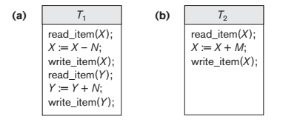
Lost Update Problem Temporary Update Problem

Slide 5
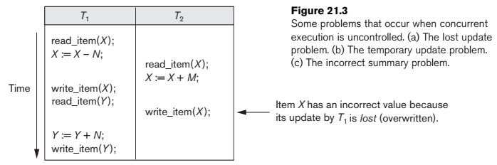

Slide 6
1 Purpose of Concurrency Control
To enforce Isolation (through mutual exclusion) among conflicting transactions.
To preserve database consistency through consistency preserving execution of transactions.
To resolve read-write and write-write conflicts.
Example:
In concurrent execution environment if T1 conflicts with T2 over a data item A, then the existing concurrency control decides if T1 or T2 should get the A and if the other transaction is rolled-back or waits.

Slide 7
Potential problems of Concurrency
Here, are some issues which you will likely to face while using the Concurrency Control method:
Lost Updates occur when multiple transactions select the same row and update the row based on the value selected
Uncommitted dependency issue occurs when the second transaction selects a row which is updated by another transaction (dirty read)
Non-Repeatable Read occurs when a second transaction is trying to access the same row several times and reads different data each time.
Incorrect Summary issue occurs when one transaction takes summary over the value of all the instances of a repeated data-item, and second transaction update few instances of that specific data-item. In that situation, the resulting summary does not reflect a correct result.

Slide 8
Why use Concurrency method?
Reasons for using Concurrency control method is DBMS:
To apply Isolation through mutual exclusion between conflicting transactions
To resolve read-write and write-write conflict issues
To preserve database consistency through constantly preserving execution obstructions
The system needs to control the interaction among the concurrent transactions. This control is achieved using concurrent-control schemes.
Concurrency control helps to ensure serializability.

Slide 9
Concurrency Control Protocols
Lock-Based Protocols
Two Phase Protocols
Timestamp-Based Protocols
Validation-Based Protocols

Slide 10
Lock-Based Protocols
A lock is a data variable which is associated with a data item.
This lock signifies that operations that can be performed on the data item.
Locks help synchronize access to the database items by concurrent transactions.
All lock requests are made to the concurrency-control manager. Transactions proceed only once the lock request is granted.

Slide 11
Simplistic Lock Protocol: This type of lock-based protocols allows transactions to obtain a lock on every object before beginning operation. Transactions may unlock the data item after finishing the 'write' operation.

Slide 12
Lock Based Protocol
Binary Locks: A Binary lock on a data item can either locked or unlocked states.
Shared Lock (S): A shared lock is also called a Read-only lock. With the shared lock, the data item can be shared between transactions.
Exclusive Lock (X): With the Exclusive Lock, a data item can be read as well as written.
X-lock is requested using lock-x instruction.
Transactions may unlock the data item after finishing the 'write' operation.

Slide 13
Lock Compatibility Matrix

Slide 14
Two-Phase Locking Techniques: Essential components
Lock Manager:
Managing locks on data items.
Lock table:
Lock manager uses it to store the identity of transaction locking a data item, the data item, lock mode and pointer to the next data item locked.
One simple way to implement a lock table is through linked list.

Slide 15
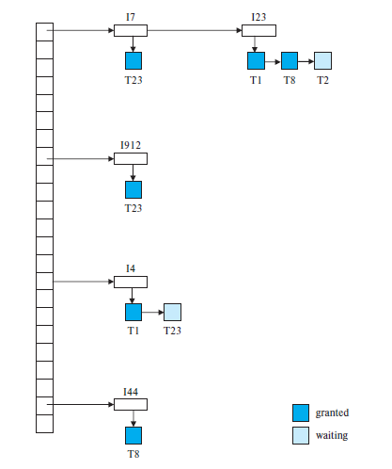
LOCK TABLE

Slide 16
Two-Phase Locking Techniques:
Essential components
Database requires that all transactions should be well-formed. A transaction is well-formed if:
It must lock the data item before it reads or writes to it.
It must not lock an already locked data items and it must not try to unlock a free data item.

Slide 17
Lock Based Protocol Example
Let account A and B are accessed by the Transaction T1 and T2.
T1 T2:
Lock S(B) Lock X (A)
Read (B) Read (A)
B=B-50 Unlock (A)
Write (B) Read S(B)
Unlock (B) Unlock (B)
Lock (A) Display (A + B)
Read (A)
A=A+50
Write (A)
Unlock (A)
If both transaction executed serially, then there is no conflict and result is remain same.
If the transaction executed parallely then Transaction T2 returns result before updation of A.
As a result the data is in inconsistent state.

Slide 18
Let account A and B are accessed by the Transaction T1 and T2.
T1 T2:
Lock S(B) Lock S (A)
Read (B) Read (A)
B=B-50 Read S(B)
Write (B) Display (A + B)
Lock (A) Unlock (A)
Read (A) Unlock (B)
A=A+50
Write (A)
Unlock (A)
Unlock (B)
In this case Transaction T2 gives the results based on the previous data. Updation of B does not affect T2.

Slide 19
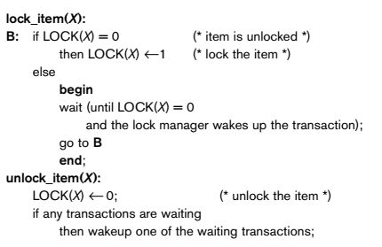
Binary Lock Example

Slide 20
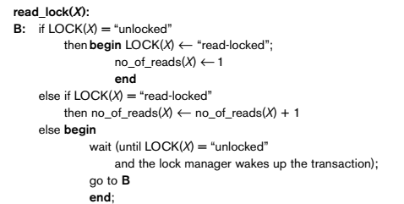
Shared Lock Example

Slide 21
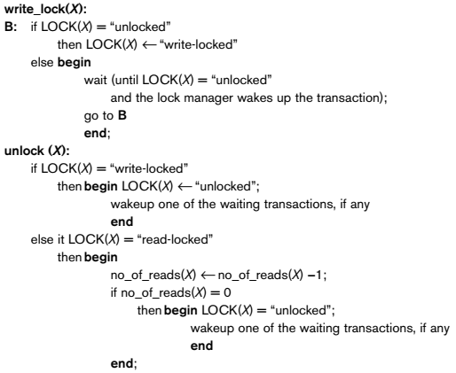
The following code performs the write lock operation
The following code performs the unlock lock operation

Slide 22
Lock conversion
Lock upgrade: existing read lock to write lock
if Ti has a read-lock (X) and Tj has no read-lock (X) (i ≠ j) then
convert read-lock (X) to write-lock (X)
else
force Ti to wait until Tj unlocks X
Lock downgrade: existing write lock to read lock
if Ti has a write-lock (X) (*no transaction can have any lock on X*)
convert write-lock (X) to read-lock (X)

Slide 23
2 Phase Locking Techniques
Two Phases:
(a) Locking (Growing)
(b) Unlocking (Shrinking).
Locking (Growing) Phase:
A transaction applies locks (read or write) on desired data items one at a time.
Unlocking (Shrinking) Phase:
A transaction unlocks its locked data items one at a time.
Requirement:
For a transaction these two phases must be mutually exclusively, that is, during locking phase unlocking phase must not start and during unlocking phase locking phase must not begin.

Slide 24
Two- Phase Locking Protocol
It is also known as a 2PL protocol. It is also called P2L.
In this type of locking protocol, the transaction should acquire a lock after it releases one of its locks.
A transaction is said to follow Two Phase Locking protocol if Locking and Unlocking can be done in two phases.
Growing Phase: New locks on data items may be acquired but none can be released.
Shrinking Phase: Existing locks may be released but no new locks can be acquired.

Slide 25
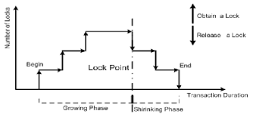
Two- Phase Locking Protocol

Slide 26
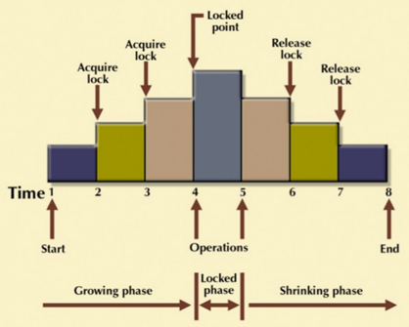
Two- Phase Locking Protocol

Slide 27
Two-Phase Locking
Two-Phase Locking Techniques: The algorithm ( Serial Execution)
T1 T2 Result
read_lock (Y); read_lock (X); Initial values: X=20; Y=30
read_item (Y); read_item (X);
unlock (Y); unlock (X);
write_lock (X); Write_lock (Y);
read_item (X); read_item (Y);
X:=X+Y; Y:=X+Y;
write_item (X); write_item (Y);
unlock (X); unlock (Y);

Slide 28
Two-Phase Locking
Two-Phase Locking Techniques: The algorithm
T1 T2 Result
read_lock (Y); read_lock (X); Initial values: X=20; Y=30
read_item (Y); read_item (X); Result of serial execution
unlock (Y); unlock (X); T1 followed by T2
write_lock (X); Write_lock (Y); X=50, Y=80.
read_item (X); read_item (Y); Result of serial execution
X:=X+Y; Y:=X+Y; T2 followed by T1
write_item (X); write_item (Y); X=70, Y=50
unlock (X); unlock (Y);

Slide 29
When transaction is non-serializable Schedule
Two-Phase Locking Techniques: The algorithm
T1 T2 Result
read_lock (Y); Initial values: X=20; Y=30
read_item (Y);
unlock (Y);
read_lock (X);
read_item (X);
unlock (X);
write_lock (Y);
read_item (Y);
Y:=X+Y;
write_item (Y);
unlock (Y);
write_lock (X);
read_item (X);
X:=X+Y;
write_item (X);
unlock (X);
Time

Slide 30
When transaction is non-serializable Schedule
Two-Phase Locking Techniques: The algorithm
T1 T2 Result
read_lock (Y); X=50; Y=50
read_item (Y); Non-serializable because it
unlock (Y); violated two-phase policy.
read_lock (X);
read_item (X);
unlock (X);
write_lock (Y);
read_item (Y);
Y:=X+Y;
write_item (Y);
unlock (Y);
write_lock (X);
read_item (X);
X:=X+Y;
write_item (X);
unlock (X);
Time

Slide 31
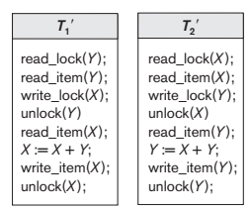
Transaction follow the 2PL
T1 and T2 follow two-phase policy but they are subject to deadlock, which must be dealt with.

Slide 32
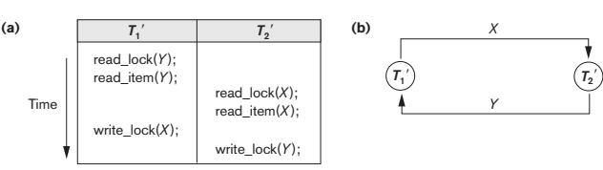
It is true that the 2PL protocol offers serializability.
However, it does not ensure that deadlocks do not happen.

Slide 33
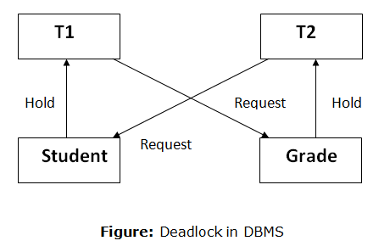

Slide 34
Two-Phase Locking Techniques: The algorithm
Two-phase policy generates two locking algorithms
(a) Basic
(b) Conservative
Conservative:
Prevents deadlock by locking all desired data items before transaction begins execution.
Basic:
Transaction locks data items incrementally. This may cause deadlock which is dealt with.
Strict:
A more stricter version of Basic algorithm where unlocking is performed after a transaction terminates (commits or aborts and rolled-back). This is the most commonly used two-phase locking algorithm.

Slide 35
Other type of 2PL
To avoid the deadlock during transaction process, the different variation of the 2PL has been described.
Strict 2PL
Rigorous 2PL
Conservative 2PL

Slide 36
Strict 2PL
Strict-Two phase locking system is almost similar to 2PL.
The only difference is that Strict-2PL never releases a lock after using it.
It require all locks (lock all the items) to access before begin transaction.
It holds all the locks until the commit point and releases all the locks at one go when the process is over.
It is not completely deadlock free.

Slide 37
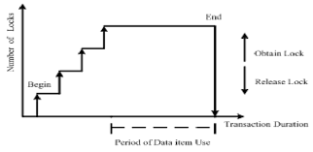

Slide 38
Rigorous 2PL
It is more restrict than strict 2PL.
Rigorous Two – Phase Locking Protocol avoids cascading rollbacks.
This protocol requires that all the share and exclusive locks to be held until the transaction commits.
It is almost free from deadlock.
Cascade Rollback: If transaction T1 fails, then rollback must be performed, then all other transactions that are dependent on T1 must be rollback.

Slide 39
Conservative 2PL Protocol
Conservative Two – Phase Locking Protocol is also called as Static Two – Phase Locking Protocol.
This protocol is almost free from deadlocks as all required items are listed in advanced.
It requires locking of all data items to access before the transaction starts.

Slide 40
Dealing with Deadlock and Starvation
Deadlock
T’1 T’2
read_lock (Y); T1 and T2 did follow two-phase
read_item (Y); policy but they are deadlock
read_lock (X);
read_item (Y);
write_lock (X);
(waits for X) write_lock (Y);
(waits for Y)
Deadlock (T’1 and T’2)

Slide 41
Dealing with Deadlock and Starvation
Deadlock prevention
A transaction locks all data items it refers to before it begins execution.
This way of locking prevents deadlock since a transaction never waits for a data item.
The conservative two-phase locking uses this approach.

Slide 42
Dealing with Deadlock and Starvation
Deadlock detection and resolution
In this approach, deadlocks are allowed to happen. The scheduler maintains a wait-for-graph for detecting cycle. If a cycle exists, then one transaction involved in the cycle is selected (victim) and rolled-back.
A wait-for-graph is created using the lock table. As soon as a transaction is blocked, it is added to the graph. When a chain like: Ti waits for Tj waits for Tk waits for Ti or Tj occurs, then this creates a cycle.

Slide 43
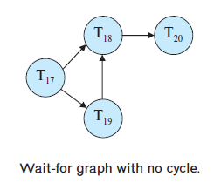
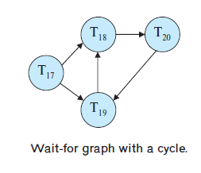

Slide 44
Recovery from Deadlock
Selection of a victim. Given a set of deadlocked transactions, we must determine which transaction (or transactions) to roll back to break the deadlock. We should roll back those transactions that will incur the minimum cost.
Rollback. Once we have decided that a particular transaction must be rolled back, we must determine how far this transaction should be rolled back.
Starvation. In a system where the selection of victims is based primarily on cost factors, it may happen that the same transaction is always picked as a victim. As a result, this transaction never completes its designated task, thus there is starvation.

Slide 45
Dealing with Deadlock and Starvation
Deadlock avoidance
There are many variations of two-phase locking algorithm.
Some avoid deadlock by not letting the cycle to complete.
That is as soon as the algorithm discovers that blocking a transaction is likely to create a cycle, it rolls back the transaction.
Wound-Wait and Wait-Die algorithms use timestamps to avoid deadlocks by rolling-back victim.

Slide 46
Dealing with Deadlock and Starvation
Starvation
Starvation occurs when a particular transaction consistently waits or restarted and never gets a chance to proceed further.
In a deadlock resolution it is possible that the same transaction may consistently be selected as victim and rolled-back.
This limitation is inherent by all the priority-based scheduling mechanisms.
In Wound-Wait scheme a younger transaction may always be wounded (aborted) by a long running older transaction which may create starvation.

Slide 47
Following schemes use transaction timestamps for the sake of deadlock prevention alone.
wait-die scheme — non-preemptive
older transaction may wait for younger one to release data item. Younger transactions never wait for older ones; they are rolled back instead.
a transaction may die several times before acquiring needed data item
wound-wait scheme — preemptive
older transaction wounds (forces rollback) of younger transaction instead of waiting for it. Younger transactions may wait for older ones.
may be fewer rollbacks than wait-die scheme.

Slide 48
Timestamp-Based Protocol
The Timestamp Ordering Protocol is used to order the transactions based on their Timestamps.
The order of transaction is nothing but the ascending order of the transaction creation.
The priority of the older transaction is higher that's why it executes first.
To determine the timestamp of the transaction, this protocol uses system time or logical counter.

Slide 49
Timestamp-Based Protocol
It works on the following manner
First a unique fixed time is associated with each transaction in the system.
These timestamps of the transaction determine the serializability order.
If the timestamp of transaction T1 is smaller than the timestamp of transaction T2, then system ensure that the transaction T1 execute first.

Slide 50
Timestamp-Based Protocol
The lock-based protocol is used to manage the order between conflicting pairs among transactions at the execution time.
But Timestamp based protocols start working as soon as a transaction is created.
Let's assume there are two transactions T1 and T2. Suppose the transaction T1 has entered the system at 007 times and transaction T2 has entered the system at 009 times. T1 has the higher priority, so it executes first as it is entered the system first.
The timestamp ordering protocol also maintains the timestamp of last 'read' and 'write' operation on a data.

Slide 51
Timestamp-Based Protocol
Schedules are serializable just like 2PL protocols
No waiting for the transaction, which eliminates the possibility of deadlocks!
Starvation is possible if the same transaction is restarted and continually aborted

Slide 52
Timestamp-Based Protocol
Each transaction is issued a timestamp when it enters the system. If an old transaction Ti has time-stamp TS(Ti), a new transaction Tj is assigned time-stamp TS(Tj) such that TS(Ti) <TS(Tj).
The protocol manages concurrent execution such that the timestamps determine the serializability order.
In order to assure such behavior, the protocol maintains for each data Q with two timestamp values:
W-timestamp(Q) is the largest time-stamp of any transaction that executed write(Q) successfully.
R-timestamp(Q) is the largest time-stamp of any transaction that executed read(Q) successfully.

Slide 53
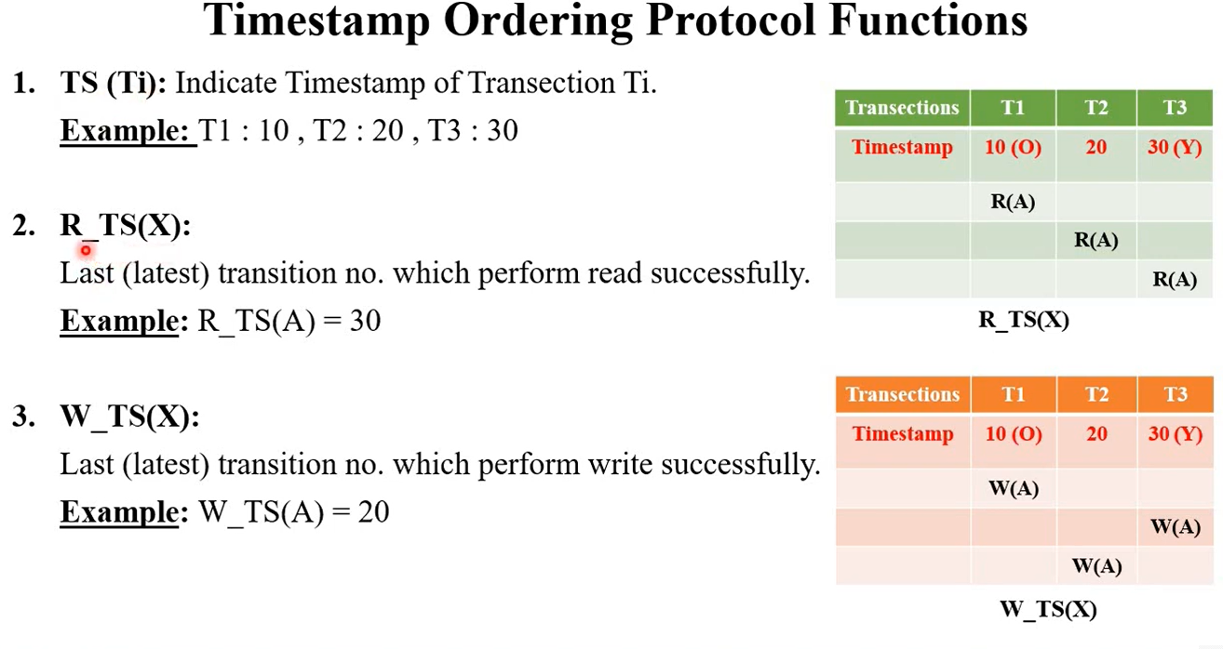

Slide 54
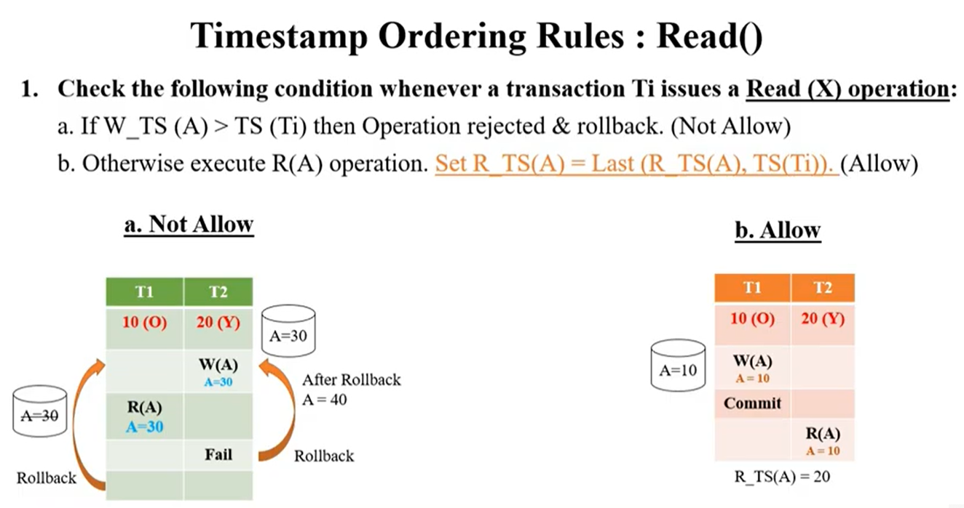

Slide 55
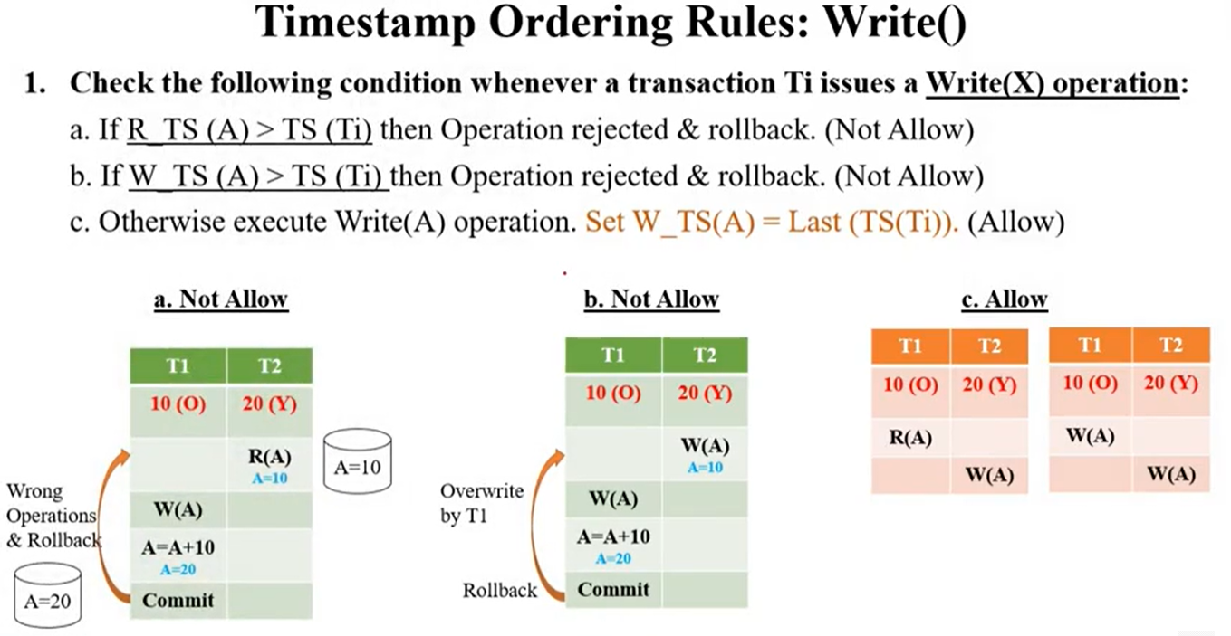

Slide 56
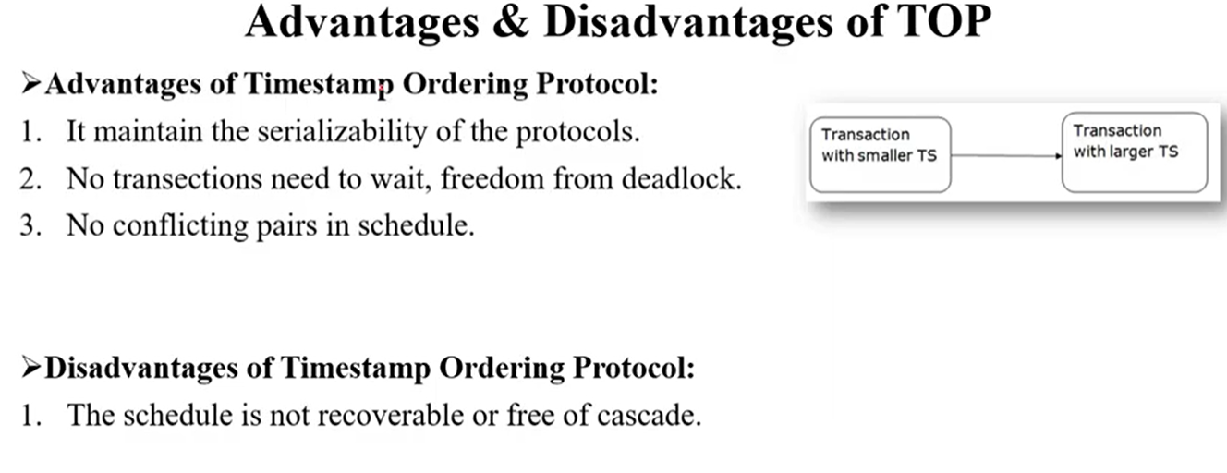

Slide 57
Timestamp-Based Protocol
Basic Timestamp Ordering
1. Transaction T issues a write_item(X) operation:
If read_TS(X) > TS(T) or if write_TS(X) > TS(T), then an younger transaction has already read the data item so abort and roll-back T and reject the operation.
If the condition in part (a) does not exist, then execute write_item(X) of T and set write_TS(X) to TS(T).
2. Transaction T issues a read_item(X) operation:
If write_TS(X) > TS(T), then an younger transaction has already written to the data item so abort and roll-back T and reject the operation.
If write_TS(X) ≤ TS(T), then execute read_item(X) of T and set read_TS(X) to the larger of TS(T) and the current read_TS(X).

Slide 58
Timestamp-Based Protocol
Timestamp based concurrency control algorithm
Strict Timestamp Ordering
1. Transaction T issues a write_item(X) operation:
If TS(T) > read_TS(X), then delay T until the transaction T’ that wrote or read X has terminated (committed or aborted).
2. Transaction T issues a read_item(X) operation:
If TS(T) > write_TS(X), then delay T until the transaction T’ that wrote or read X has terminated (committed or aborted).

Slide 59
Timestamp-Based Protocol
Timestamp based concurrency control algorithm
Thomas’s Write Rule
If read_TS(X) > TS(T) then abort and roll-back T and reject the operation.
If write_TS(X) > TS(T), then just ignore the write operation and continue execution. This is because the most recent writes counts in case of two consecutive writes.
Otherwise (If the conditions given in 1 and 2 above do not occur,) then execute write_item(X) of T and set write_TS(X) to TS(T).

Slide 60
Timestamp-Based Protocol
Multi version concurrency control techniques:
This approach maintains a number of versions of a data item and allocates the right version to a read operation of a transaction. Thus unlike other mechanisms a read operation in this mechanism is never rejected.
Side effect:
Significantly more storage (RAM and disk) is required to maintain multiple versions. To check unlimited growth of versions, a garbage collection is run when some criteria is satisfied.

Slide 61
Timestamp-Based Protocol
Multiversion technique based on timestamp ordering
Assume X1, X2, …, Xn are the version of a data item X created by a write operation of transactions. With each Xi a read_TS (read timestamp) and a write_TS (write timestamp) are associated.
read_TS(Xi): The read timestamp of Xi is the largest of all the timestamps of transactions that have successfully read version Xi.
write_TS(Xi): The write timestamp of Xi that wrote the value of version Xi. A new version of Xi is created only by a write operation.

Slide 62
Timestamp-Based Protocol
Multiversion technique based on timestamp ordering
To ensure serializability, the following two rules are used.
If transaction T issues write_item (X) and version i of X has the highest write_TS(Xi) of all versions of X that is also less than or equal to TS(T), and read _TS(Xi) > TS(T), then abort and roll-back T; otherwise create a new version Xj of X with read_TS(Xj) = write_TS(Xj) = TS(T)
If transaction T issues read_item (X), find the version i of X that has the highest write_TS(Xi) of all versions of X that is also less than or equal to TS(T), then return the value of Xi to Transaction T, and set the value of read _TS(Xi) to the largest of TS(T) and the current read_TS(Xi).
Rule 2 guarantees that a read will never be rejected.

Slide 63
Graph-Based Protocols
The simplest model requires to have prior knowledge about the order in which the database items will be accessed.
To acquire such prior knowledge, we impose a partial ordering → on the set D = {d1, d2,…, dh} of all data items.
If di → dj, then any transaction accessing both di and dj must access di before accessing dj.
This partial ordering may be the result of either the logical or the physical organization of the data, or it may be imposed solely for the purpose of concurrency control.

Slide 64
The partial ordering implies that the set D may now be viewed as a directed acyclic graph, called a database graph.
We shall present a simple protocol, called the tree protocol, which is restricted to employ only exclusive locks
In the tree protocol, the only lock instruction allowed is lock-X. Each transaction Ti can lock a data item at most once, and must observe the following rules:
1. The first lock by Ti may be on any data item.
2. Subsequently, a data item Q can be locked by Ti only if the parent of Q is currently locked by Ti.
3. Data items may be unlocked at any time.
4. A data item that has been locked and unlocked by Ti cannot subsequently be relocked by Ti.

Slide 65
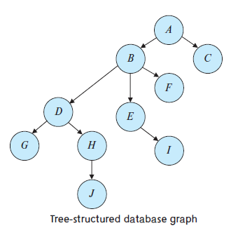
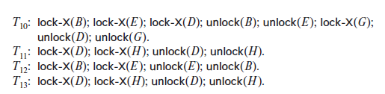
consider the following database graph with four transactions follow the tree protocol on this graph.
We show only the lock and unlock instructions:

Slide 66
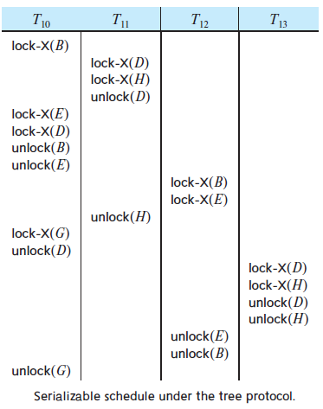

Slide 67
One possible schedule in which these four transactions participated appears in Figure
Note that, during its execution, transaction T10 holds locks on two disjoint subtrees. Observe that the schedule of Figure is conflict serializable.
It can be shown not only that the tree protocol ensures conflict serializability, but also that this protocol ensures freedom from deadlock.
The tree protocol in Figure does not ensure recoverability and cascadelessness.
To ensure recoverability and cascadelessness, the protocol can be modified to not permit release of exclusive locks until the end of the transaction.
Holding exclusive locks until the end of the transaction reduces concurrency.

Slide 68
Here is an alternative that improves concurrency, but ensures only recoverability:
For each data item with an uncommitted write, we record which transaction performed the last write to the data item.
Whenever a transaction Ti performs a read of an uncommitted data item, we record a commit dependency of Ti on the transaction that performed the last write to the data item.
Transaction Ti is then not permitted to commit until the commit of all transactions on which it has a commit dependency.
If any of these transactions aborts, Ti must also be aborted

Slide 69
Advantages (over Two phase locking)
It is deadlock-free, so no rollbacks are required.
unlocking may occur earlier. Earlier unlocking may lead to shorter waiting times and to an increase in concurrency.
Disadvantage
In some cases, a transaction may have to lock data items that it does not access.
For example, a transaction that needs to access data items A and J in the database graph must lock not only A and J, but also data items B, D, and H.
This additional locking results in increased locking overhead, the possibility of additional waiting time, and a potential decrease in concurrency.
Further, without prior knowledge of what data items will need to be locked, transactions will have to lock the root of the tree, and that can reduce concurrency greatly.

Slide 70
Granularity of data items and Multiple Granularity Locking
A lockable unit of data defines its granularity. Granularity can be coarse (entire database) or it can be fine (a tuple or an attribute of a relation).
Data item granularity significantly affects concurrency control performance. Thus, the degree of concurrency is low for coarse granularity and high for fine granularity.
Example of data item granularity:
A field of a database record (an attribute of a tuple)
A database record (a tuple or a relation)
A disk block
An entire file
The entire database

Slide 71
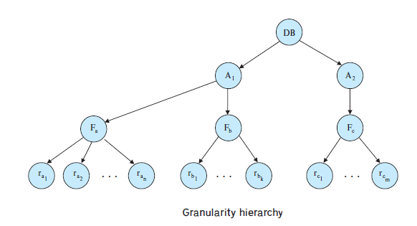
Granularity of data items and Multiple Granularity Locking
The following diagram illustrates a hierarchy of granularity from coarse (database) to fine (record).
Database
Area
File
Record

Slide 72
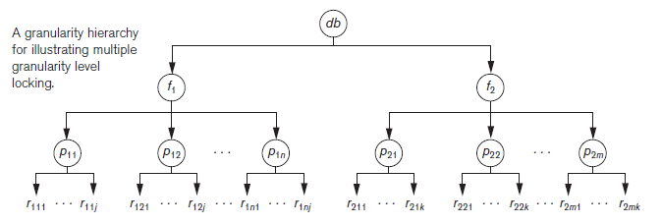
Suppose transaction T1 wants to update all the records in file f1, and T1 requests and is granted an exclusive lock for f1. Then all of f1’s pages (p11 through p1n)—and the records contained on those pages—are locked in exclusive mode. This is beneficial for T1 because setting a single file-level lock is more efficient than setting n page-level locks or having to lock each individual record.
Now suppose another transaction T2 only wants to read record r1nj from page p1n of file f1; then T2 would request a shared record-level lock on r1nj.

Slide 73
A more efficient way to gain this knowledge is to introduce a new class of lock modes, called intention lock modes.
If a node is locked in an intention mode, explicit locking is done at a lower level of the tree (that is, at a finer granularity).
Intention locks are put on all the ancestors of a node before that node is locked explicitly.
Thus, a transaction does not need to search the entire tree to determine whether it can lock a node successfully.
A transaction wishing to lock a node—say, Q—must traverse a path in the tree from the root to Q.
While traversing the tree, the transaction locks the various nodes in an intention mode.

Slide 74
To manage such hierarchy, in addition to read and write, three additional locking modes, called intention lock modes are defined:
Intention-shared (IS):
Intention-exclusive (IX):
Shared-intention-exclusive (SIX):

Slide 75
There is an intention mode associated with shared mode, and there is one with exclusive mode.
If a node is locked in intention-shared (IS) mode, intension to acquire a shared lock at a higher level, it signals the desire to read or access shared resources in the higher-level while allowing other transactions to hold shared locks at lower level.
Similarly, if a node is locked in intention-exclusive (IX) mode, then explicit locking is being done at a lower level, with exclusive-mode or shared-mode locks.
Finally, if a node is locked in shared and intention-exclusive (SIX) mode, the node is locked in shared mode, and some nodes are locked in exclusive mode by the same transactions. In other words, the subtree rooted by that node is locked explicitly in shared mode, and that explicit locking is being done at a lower level with exclusive-mode locks

Slide 76
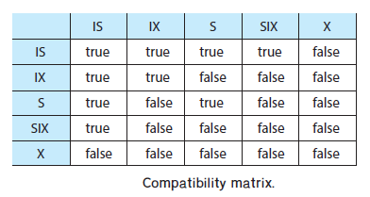
These locks are applied using the following compatibility matrix:
Intention-shared (IS
Intention-exclusive (IX)
Shared-intention-exclusive (SIX)

Slide 77
Granularity of data items and Multiple Granularity Locking
The set of rules which must be followed for producing serializable schedule are
The lock compatibility must adhered to.
The root of the tree must be locked first, in any mode..
A node N can be locked by a transaction T in S or IX mode only if the parent node is already locked by T in either IS or IX mode.
A node N can be locked by T in X, IX, or SIX mode only if the parent of N is already locked by T in either IX or SIX mode.
T can lock a node only if it has not unlocked any node (to enforce 2PL policy).
T can unlock a node, N, only if none of the children of N are currently locked by T.

Slide 78
Granularity of data items and Multiple Granularity Locking:
An example of a serializable execution:
T1 T2 T3
IX(db)
IX(f1)
IX(db)
IS(db)
IS(f1)
IS(p11)
IX(p11)
X(r111)
IX(f1)
X(p12)
S(r11j)
IX(f2)
IX(p21)
IX(r211)
Unlock (r211)
Unlock (p21)
Unlock (f2)
S(f2)

Slide 79
Granularity of data items and Multiple Granularity Locking: An example of a serializable execution (continued):
T1 T2 T3
unlock(p12)
unlock(f1)
unlock(db)
unlock(r111)
unlock(p11)
unlock(f1)
unlock(db)
unlock (r111j)
unlock (p11)
unlock (f1)
unlock(f2)
unlock(db)

